Slide 1

Feedback Control 1
COMSM4111 Robotic Systems
Anonymous Feedback form:
https://forms.gle/PyQQy2mwzyATFmJW6
Padlet board (questions & comments):
http://padlet.com/paul_odowd1/1lhoodwv2fuc
Delivered by:
Paul O’Dowd paul.odowd@bristol.ac.uk

Slide 2
House Keeping
Change to lecture ordering
Some typos fixed in Labsheets – no major changes.

Slide 3
Lab Sessions / Sheets
Week 1
Week 2
Week 3
Week 4
Week 5
Week 6
Week 7
Meet the Romi
Millis()
Encoders
PID
Line Following
Finite State Machine
Motors
Time & Speed
Kinematics
Lectures
Intro
Sensors & Actuators
Feedback Control 2
Probabilistic Robotics
System
Architectures
Path Planning
Experimental Robotics
Micro-controllers
Feedback Control 1
Kinematics
PID Drop-In
Sensor Fusion
Searching & Mapping
Toward
Assessment 2
Assessment Op 1
Assessment Op 2
Assessment Op 3

Slide 4
This Lecture:
Feedback Control – Open Loop / Closed Loop
PID Proportional
When to use Integral
Encoders
Demand-Output Relationship
Position Control
Notes:
The learning outcomes for this lecture are to:
Grasp a fundamental (deep) understanding of how we use microcontroller peripherals like Timers, Interrupts, etc.
This means knowing something of how computers work…
…and why we then write software the way we do.
Ordinarily, this is difficult to grasp by ‘just doing it’, it needs to be taught.
We will also looks at how it is done on Arduino (surface level understanding).
You should be able to apply all this in the lab session.
Hopefully, the strange software will make more sense after this.

Slide 5
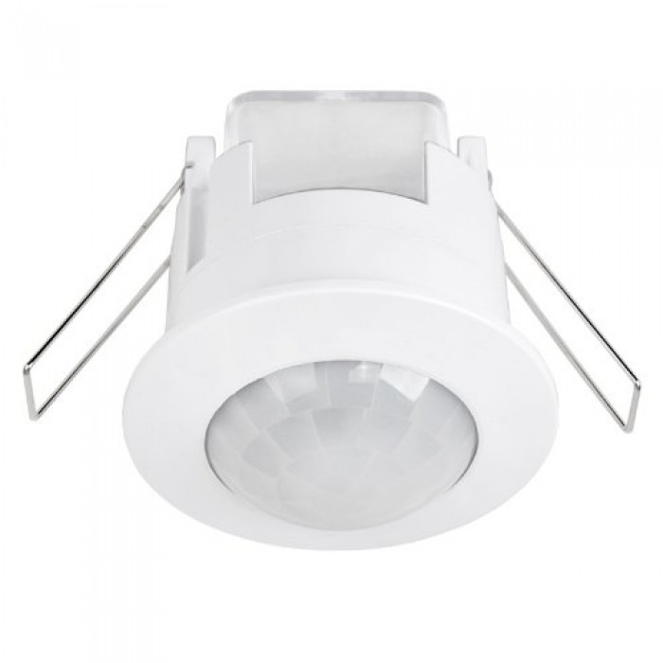

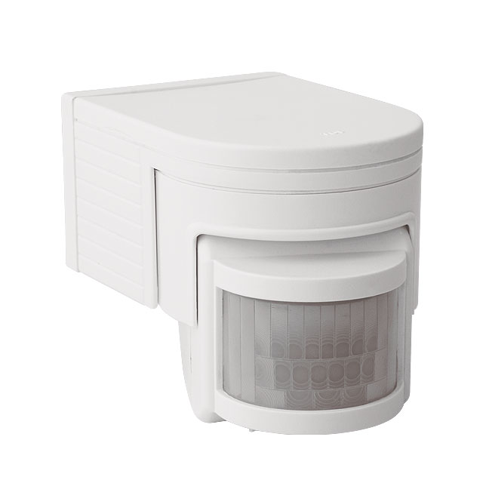
Open Loop Control
Motion Sensor
Timer Circuit
Light Circuit

Slide 6
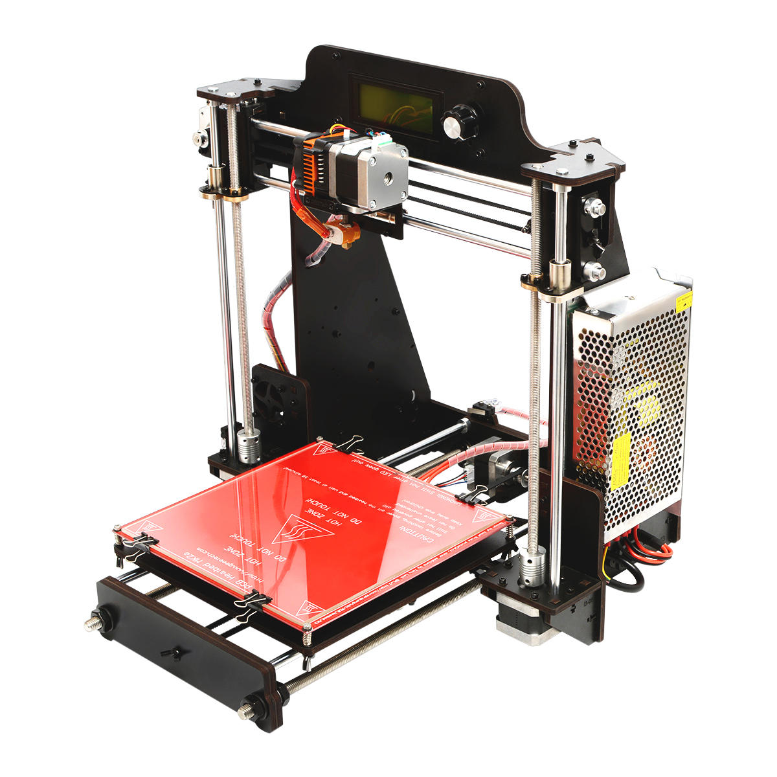
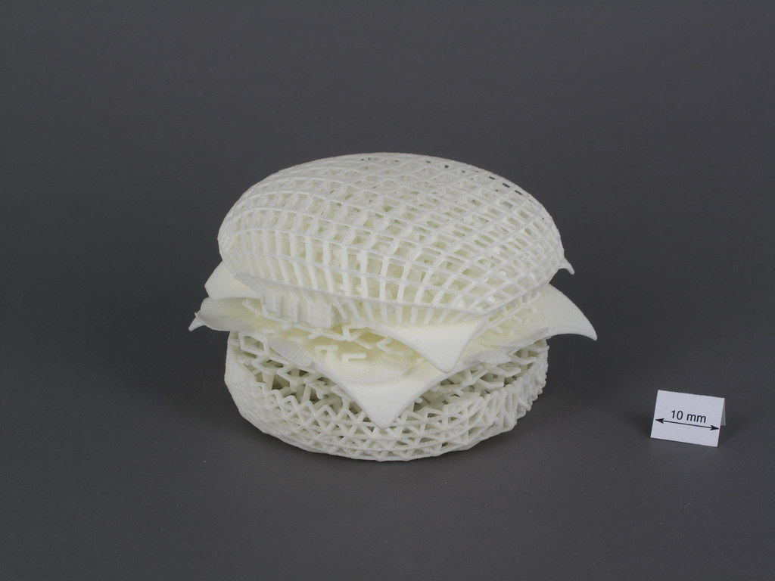
Open Loop Control
Trajectory
Motor Activation
Material Extrusion
(*nozzle temperature is regulated)

Slide 7
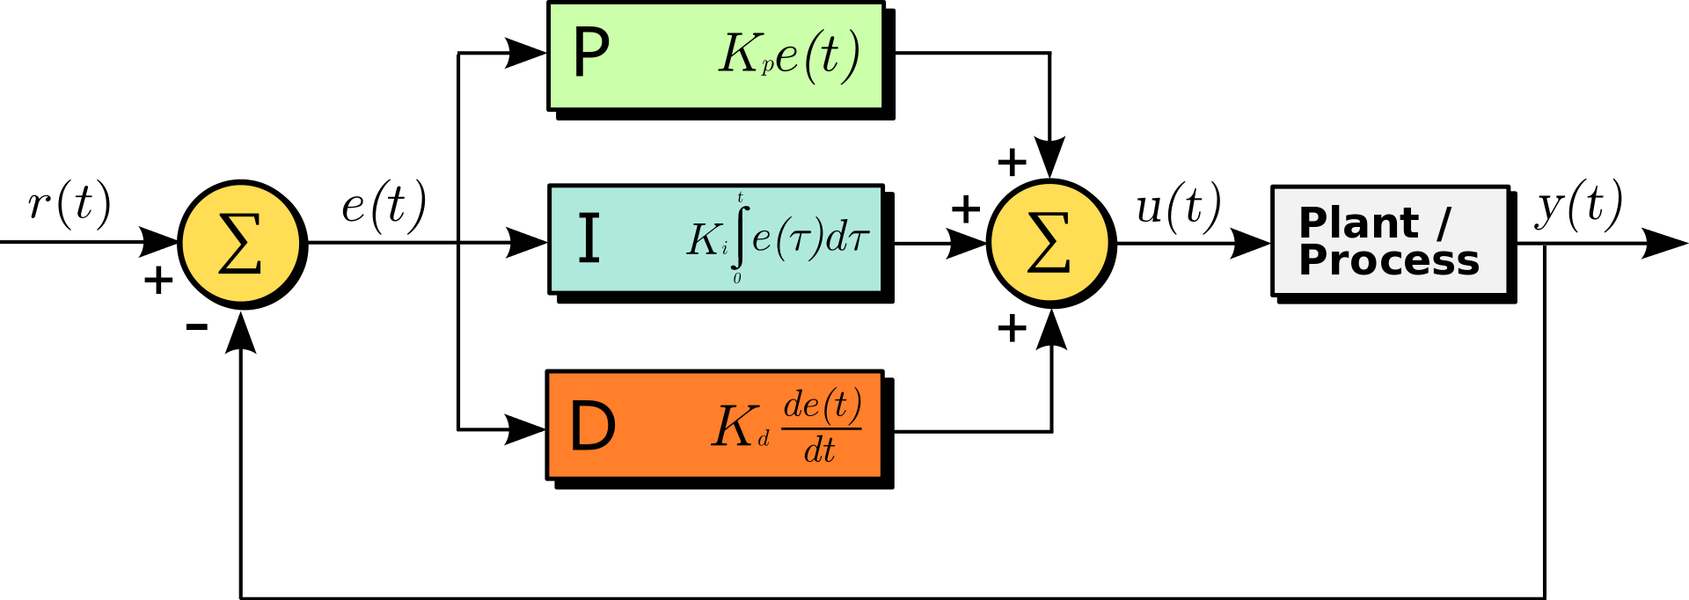

Closed Loop Control
Demand
Feedback
Output
Measurement

Slide 8
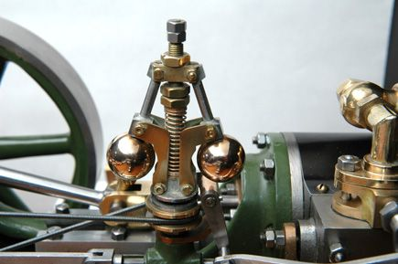
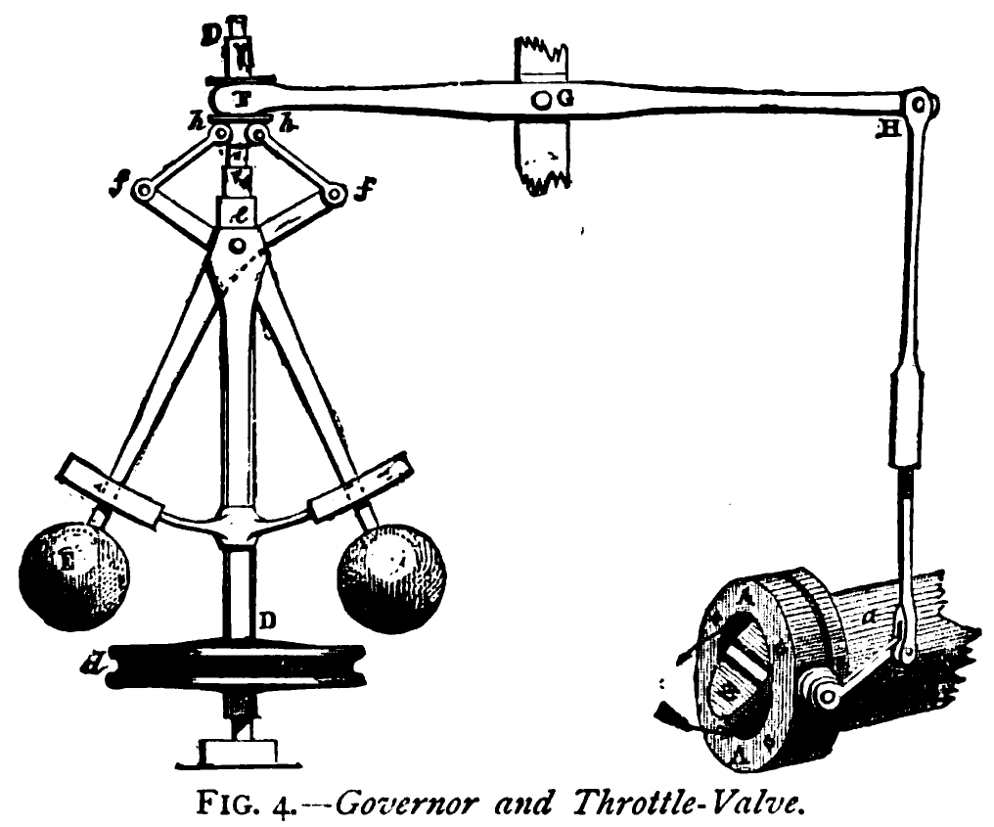
Closed Loop Control
Demand
Feedback
Output
Measurement
Steam Engine Governor

Slide 9
Closed Loop Control
Demand
Feedback
Output
Measurement
Steam Engine Governor
Mechanical Lever
Proportional Response
Spring “dampens”
Resists sudden change
Mass has momentum
“integrates”

Slide 10
Closed Loop Control
Demand
Feedback
Output
Measurement
Steam Engine Governor
Abstract Relationship:
Controls fuel by
“measuring” angular speed
to
actuate valve

Slide 11
Closed Loop Control
p-term
i-term
d-term

Slide 12
Closed Loop Control
Kp, Ki, and Kd are “gain” values.
Used to control the contribution of the p-term, i-term and d-term respectively.
p-term
i-term
d-term

Slide 13
This Lecture:
Feedback Control – Open Loop / Closed Loop
PID Proportional
When to use Integral
Encoders
Demand-Output Relationship
Position Control
Notes:
The learning outcomes for this lecture are to:
Grasp a fundamental (deep) understanding of how we use microcontroller peripherals like Timers, Interrupts, etc.
This means knowing something of how computers work…
…and why we then write software the way we do.
Ordinarily, this is difficult to grasp by ‘just doing it’, it needs to be taught.
We will also looks at how it is done on Arduino (surface level understanding).
You should be able to apply all this in the lab session.
Hopefully, the strange software will make more sense after this.

Slide 14
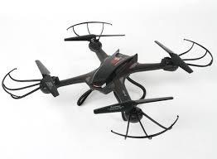
Closed Loop Control (Proportional)
Demand
Feedback
Output
Measurement
Altitude
Desired Altitude (demand)
Error
Current Altitude (measurement)

Slide 15
Closed Loop Control (Proportional)
Demand
Feedback
Output
Measurement
Altitude
Desired Altitude (demand) = 300
Output (t-1) = 50
(not good enough)
Error = 200
Current Altitude (measurement) = 100

Slide 16
Closed Loop Control (Proportional)
Demand
Feedback
Output
Measurement
Altitude
Desired Altitude (demand) = 300
Output (t-1) = 50
(not good enough)
Error = 200
Current Altitude (measurement) = 100
8-bit PWM?
16-bit Barometer?

Slide 17
Closed Loop Control (Proportional)
Demand
Feedback
Output
Measurement
Altitude
Desired Altitude (demand) = 300
Output = 20,000
Error = 200 x 100
Current Altitude (measurement) = 100

Slide 18
Closed Loop Control (Proportional)
Demand
Feedback
Output
Measurement
Altitude
Desired Altitude (demand) = 300
Error = 200 x 0.01
Output = 2
Current Altitude (measurement) = 100

Slide 19
Closed Loop Control (Proportional)
Demand
Feedback
Output
Measurement
Altitude
Desired Altitude (demand) = 300
Output = 160
Error = 200 x 0.8
Current Altitude (measurement) = 100

Slide 20
Closed Loop Control (Proportional)
Demand
Feedback
Output
Measurement
Altitude
Desired Altitude (demand) = 300
What is this relationship?
Output = 160
Error = 200 x 0.8
Current Altitude (measurement) = 100

Slide 21
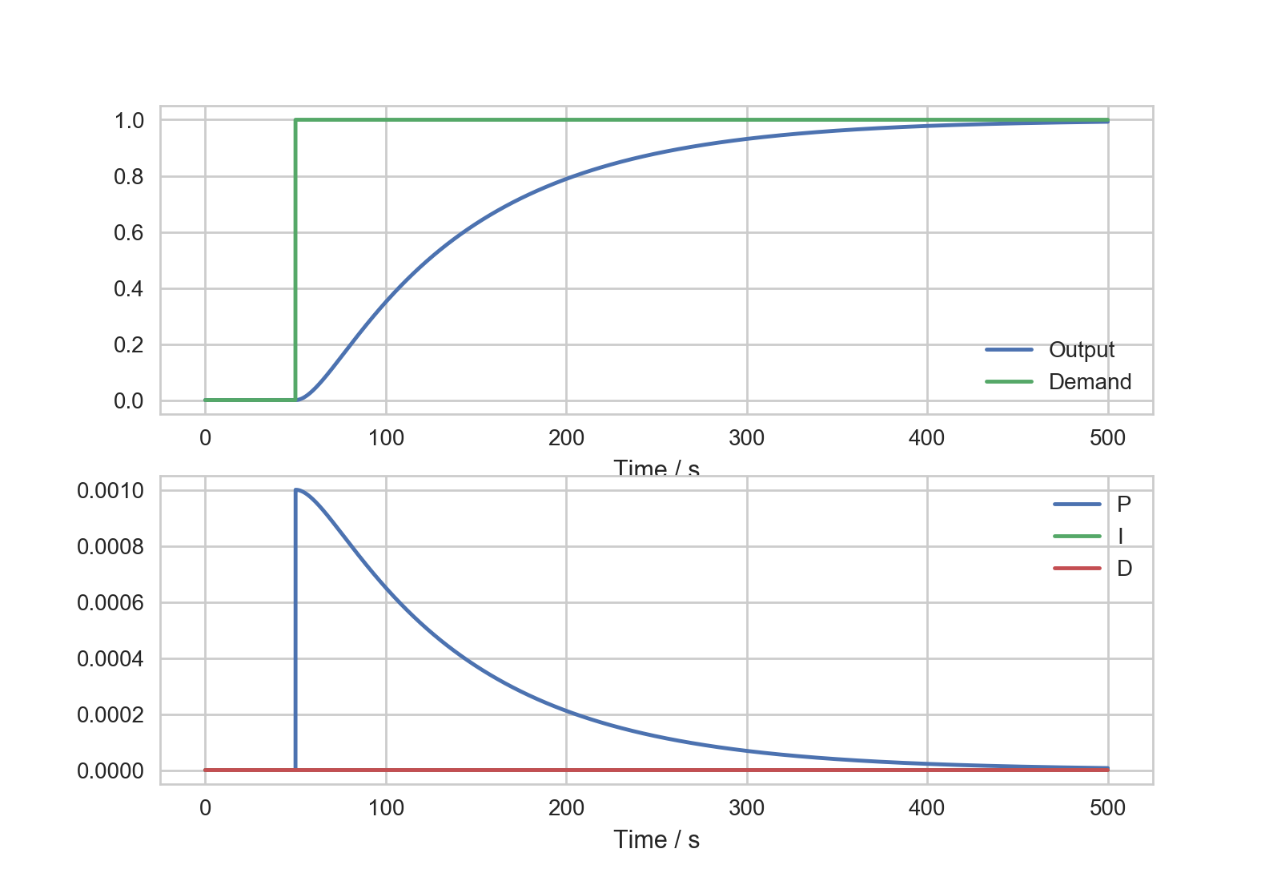
Closed Loop Control (Proportional)
“ideal” (not quite)
Rise Time

Slide 22
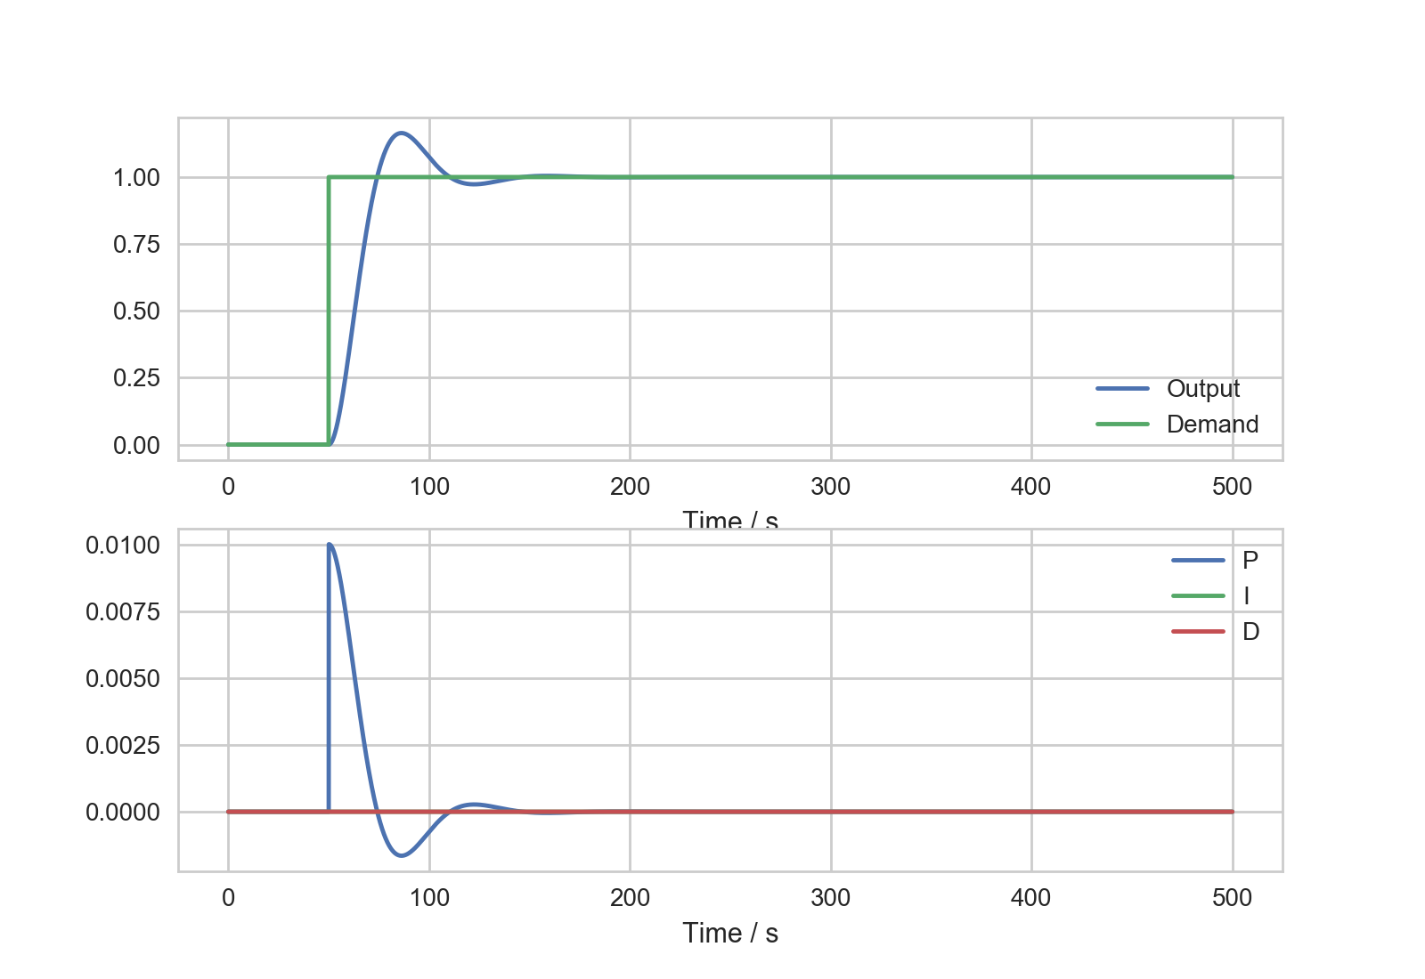
Closed Loop Control (Proportional)
“Aggressively Tuned”
Rise Time
Overshoot

Slide 23
Closed Loop Control (Proportional)
“Under Tuned”
Slow Rise Time
Steady-State
Error

Slide 24
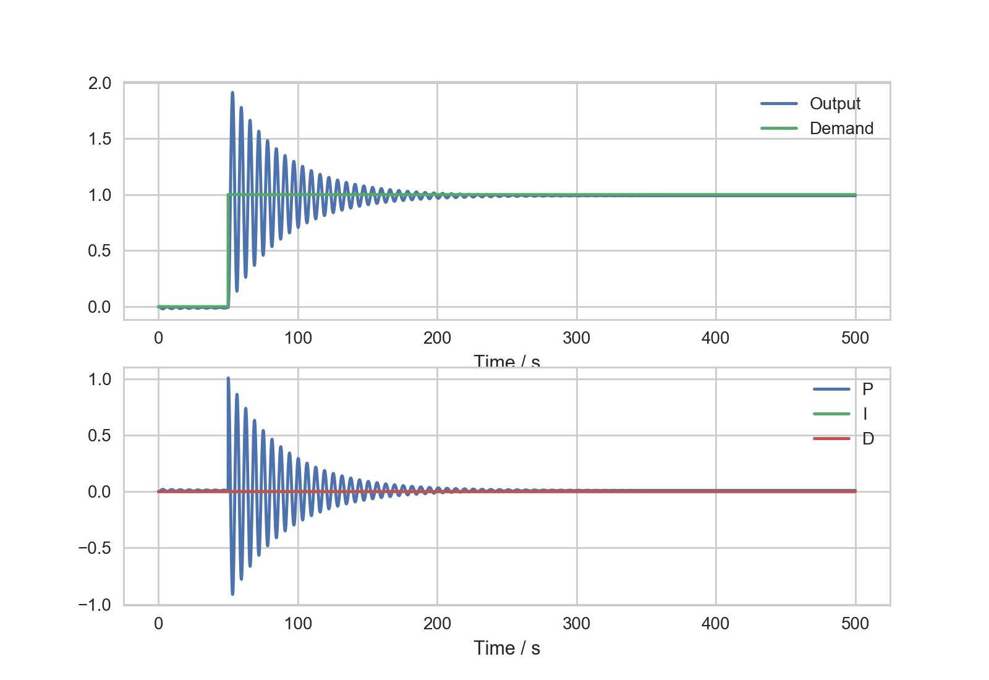
Closed Loop Control (Proportional)

Slide 25
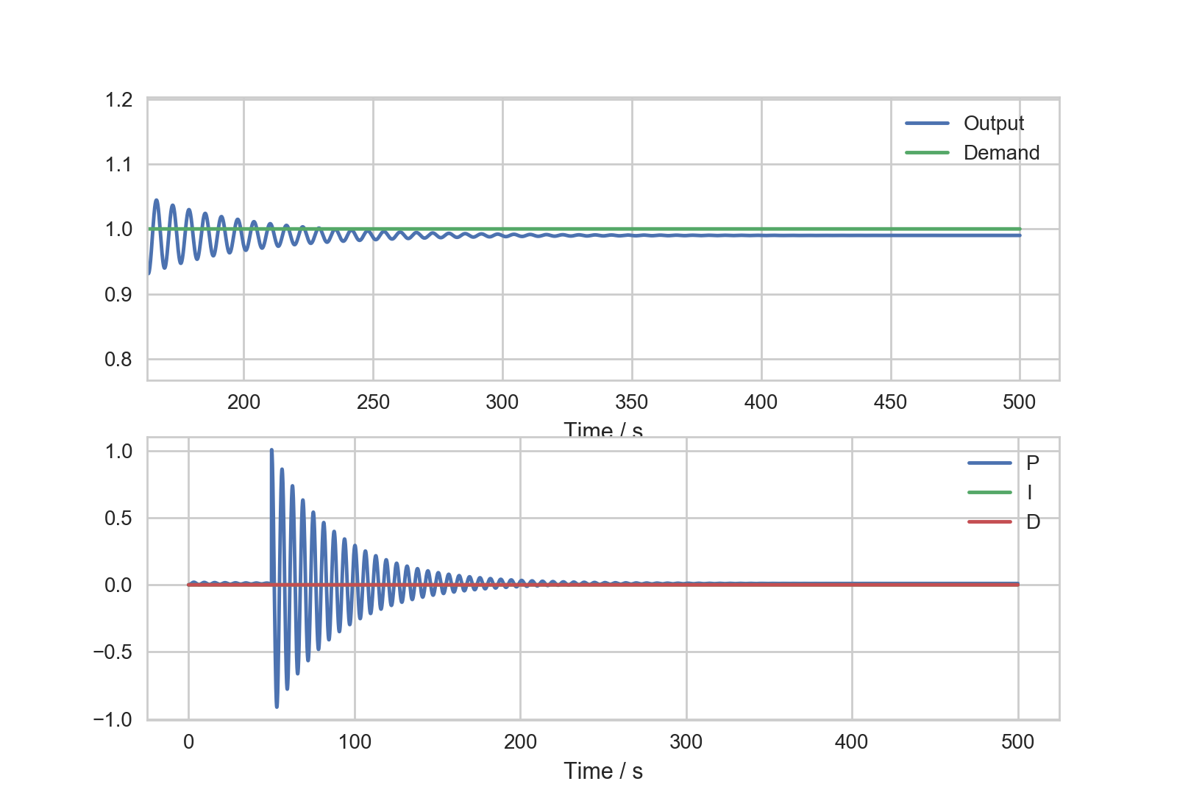
Closed Loop Control (Proportional)
Steady-state
Error

Slide 26
What might cause this steady-state error?

Slide 27

Closed Loop Control (Proportional)
Demand
Feedback
Output
Measurement
Altitude
Current Altitude (measurement) = 300
Desired Altitude (demand) = 300
?
Output = 160
Error (t+1) = 0 x 0.8

Slide 28
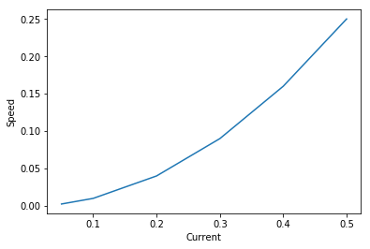
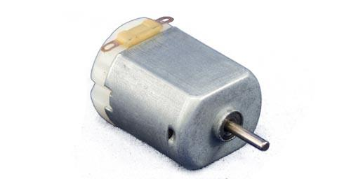
Closed Loop Control (Proportional)
Non-Linear Actuators
Ground Effect
Gravity
Non-Linear Load

Slide 29
This Lecture:
Feedback Control – Open Loop / Closed Loop
PID Proportional
When to use Integral
Encoders
Demand-Output Relationship
Position Control
Notes:
The learning outcomes for this lecture are to:
Grasp a fundamental (deep) understanding of how we use microcontroller peripherals like Timers, Interrupts, etc.
This means knowing something of how computers work…
…and why we then write software the way we do.
Ordinarily, this is difficult to grasp by ‘just doing it’, it needs to be taught.
We will also looks at how it is done on Arduino (surface level understanding).
You should be able to apply all this in the lab session.
Hopefully, the strange software will make more sense after this.

Slide 30
When to use Integral
demand
Time ->

Slide 31
When to use Integral
demand
measurement, steady-state error
P-term, tails off as error reaches
close to zero
Time ->

Slide 32
When to use Integral
Integral is producing an increasing value
as long as the system has steady-state error
Integral-term
demand
measurement, steady-state error
Time ->

Slide 33
When to use Integral
By including the integral, the system gets pushed on, so the measurement continues on toward demand.
measurement
demand
Time ->

Slide 34
When to use Integral
At this point, there is now error with the other sign (overshoot)
measurement
demand
Time ->

Slide 35
When to use Integral
The integral will therefore “wind-down”, and the system will head down toward error = 0
measurement
demand
Time ->

Slide 36
When to use Integral
delay integrating new error, i-term has small gain
measurement
demand
Time ->

Slide 37
When to use Integral
The integral will keep a “high” value, compensating for gravity, stiction, etc. even though the p-term is near zero.
measurement
demand
Time ->

Slide 38
This Lecture:
Feedback Control – Open Loop / Closed Loop
PID Proportional
When to use Integral
Encoders
Demand-Output Relationship
Position Control
Notes:
The learning outcomes for this lecture are to:
Grasp a fundamental (deep) understanding of how we use microcontroller peripherals like Timers, Interrupts, etc.
This means knowing something of how computers work…
…and why we then write software the way we do.
Ordinarily, this is difficult to grasp by ‘just doing it’, it needs to be taught.
We will also looks at how it is done on Arduino (surface level understanding).
You should be able to apply all this in the lab session.
Hopefully, the strange software will make more sense after this.

Slide 39
Encoders (Measurement) Labsheet 4

Slide 40
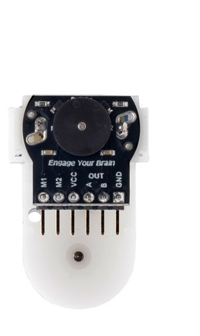
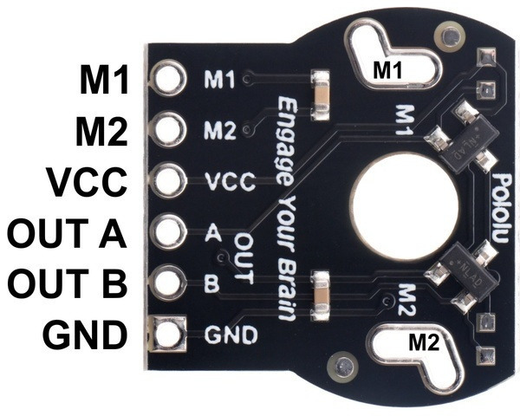
Encoders

Slide 41
Encoders
If:
Channel A goes from LOW to HIGH
and Channel B is LOW
You are going CLOCKWISE!
Or if:
Channel A goes from LOW to HIGH
and Channel B is HIGH
You are going COUNTER-CLOCKWISE!

Slide 42
Clockwise
A
B

Slide 43
Anti- Clockwise
A
B

Slide 44
Quick Demo (Polling vs Interrupts)

Slide 45
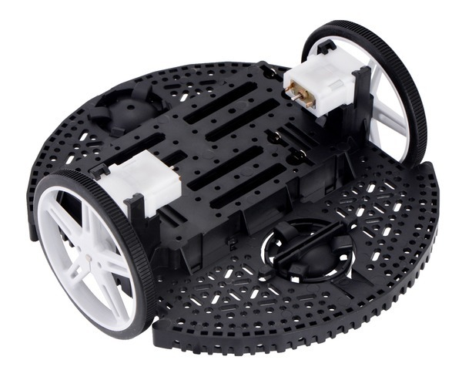
Encoders
+1
+1
Tracking over time provides
Angular Speed
+1
+1
+1
Using geometry of robot,
can calculate distance
covered.
+1
+1
+1
+1

Slide 46
Encoders
+1
+1
Tracking over time provides
Angular Speed
+1
+1
PID Speed Controller
+1
Using geometry of robot,
can calculate distance
covered.
+1
+1
+1
+1
PID Position Controller

Slide 47
Quick Look at Romi Demo

Slide 48
This Lecture:
Feedback Control – Open Loop / Closed Loop
PID Proportional
When to use Integral
Encoders
Demand-Output Relationship
Position Control
Notes:
The learning outcomes for this lecture are to:
Grasp a fundamental (deep) understanding of how we use microcontroller peripherals like Timers, Interrupts, etc.
This means knowing something of how computers work…
…and why we then write software the way we do.
Ordinarily, this is difficult to grasp by ‘just doing it’, it needs to be taught.
We will also looks at how it is done on Arduino (surface level understanding).
You should be able to apply all this in the lab session.
Hopefully, the strange software will make more sense after this.

Slide 49
Demand-Output Relationship

Slide 50
Demand-Output Relationship
Demand
P + I + D
Output
Measurement
Typical problems:
Erratic Behaviour
Oscillations / Stuttering
“sometimes works”
A nightmare when trying to tune your gains (Kp, Ki, Kd)

Slide 51
Speed Controller
+1
+1
Tracking over time provides
Angular Speed
+1
+1
PID Speed Controller
Demand is encoder counts per second
(and to maintain this)

Slide 52
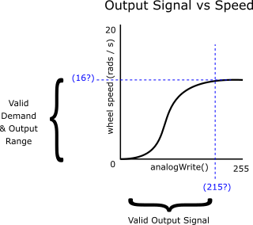
Speed Controller (demand/output)
There is a finite range of wheel speed the robot can produce.
Therefore, there is a limited “sensible” range of demand on the system.
There is a feasible relationship between a sensible demand and the output signal.

Slide 53
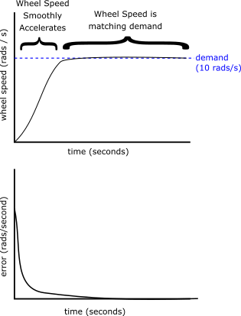
Speed Controller (ideal response)
When error = 0 and demand is not 0, power is maintained.
The output signal will compensate for a varying load.

Slide 54
Position Controller
+1
456 counts
Using geometry of robot,
can calculate distance
covered.
+1
+1
+1
+1
PID Position Controller
Demand is to arrive at encoder count
(and stop)

Slide 55
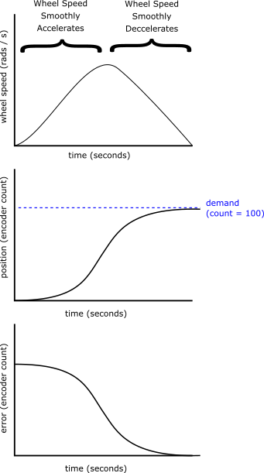
Position Controller (ideal response)
Ideally, output should slowly increase and decrease.
Output should come to 0 when demand is reached (error = 0), robot at destination.
PID controller should not saturate to maximum speed. This causes integral wind-up.

Slide 56
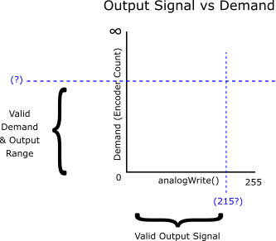
Position Controller (demand/output)
Demand is an encoder count, up to infinity.
Motor speed is finite, without direct relationship to the demand.
A “sensible” demand must be managed.

Slide 57
Position Controller – demand done badly

Slide 58
Remember Integral wind-down?
The integral will therefore “wind-down”, and the system will head down toward error = 0
demand
measurement, steady-state error
P-term, tails off as error reaches
close to zero
Time ->

Slide 59
Bad position demand
P-term, saturates output to maximum motor speed.
Time ->

Slide 60
Bad position demand
Robot is travelling to demand (a long distance, a long time).
The PID controller is unresponsive (it is not dynamic).
Time ->

Slide 61
Bad position demand
Robot is travelling to demand (a long distance, a long time).
Error is decreasing toward zero.
Time ->

Slide 62
Bad position demand
Robot is travelling to demand (a long distance, a long time).
P-term finally responds and drops down to 0 appropriately.
Time ->

Slide 63
Bad position demand
Because the system has been in error for a long time, the integral term has gone to a huge value – integral wind-up
Time ->

Slide 64
Bad position demand
When the robot arrives at the demand, the p-term shrinks to zero to stop the robot.
Therefore, error = 0,
No correction for our i-term.
Time ->

Slide 65
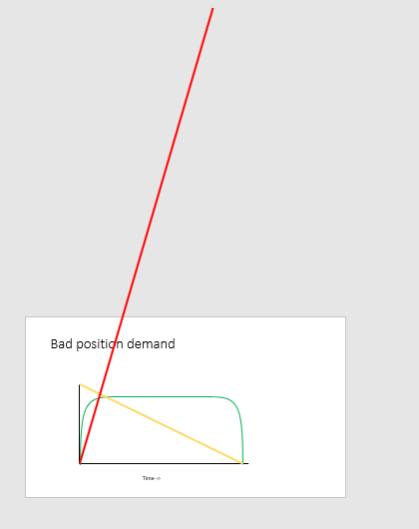
However we still need to bring down this integral….
So the robot is going to do a crazy overshoot, and it would need as much time in error in the other direction to bring the integral back down – you’ll see oscillation.

Slide 66
Good position demand
Big position demands need to be decomposed into smaller demands.
A position demand shouldn’t saturate the controller output, e.g., we shouldn’t observe integral wind-up.
It is common to use a PD (proportional-derivative) controller for position.
Integral can still be useful for very small position demands, pushing the controller over stiction.

Slide 67
This Lecture:
Feedback Control – Open Loop / Closed Loop
PID Proportional
When to use Integral
Encoders
Demand-Output Relationship
Position Control
Notes:
The learning outcomes for this lecture are to:
Grasp a fundamental (deep) understanding of how we use microcontroller peripherals like Timers, Interrupts, etc.
This means knowing something of how computers work…
…and why we then write software the way we do.
Ordinarily, this is difficult to grasp by ‘just doing it’, it needs to be taught.
We will also looks at how it is done on Arduino (surface level understanding).
You should be able to apply all this in the lab session.
Hopefully, the strange software will make more sense after this.

Slide 68
PID Tuning Tips
Trial-and-Error
Start with Proportional Only
Find the gain value for closest undershoot
Find the gain value for first instance of oscillation
Try to dampen oscillation with Derivative
You may need to lower your Kp
You will probably still see undershoot (steady-state error)
But see if you can decrease the rise time whilst keeping overshoot low.
Compensate for undershoot by adding in the i-term
Start with very small values of Ki.

Slide 69
Q&A
Anonymous Feedback form:
https://forms.gle/PyQQy2mwzyATFmJW6
Padlet board (questions & comments):
http://padlet.com/paul_odowd1/1lhoodwv2fuc
Delivered by:
Paul O’Dowd paul.odowd@bristol.ac.uk

